Slide 1
Navigating Your Path
as an EHS Professional
Dr. David E. Oliver

Slide 2
Key Points:
The Rapidly Changing Terrain of Safety Practice
Maintaining an all-Hazards view of your Organization
Be an Honor Student in Positive Leadership
Safety Expert as an Agent of Change
The Advantage of Having a Co-Credential
Embrace Life-Long Learning for Yourself and Your Team
Be Malleable in Method but Steadfast in Principles
Actively Drive Networking Beyond Electronic Media
Establish Your Personal Priorities Wisely

Slide 3
The Rapidly Changing Terrain of Safety Practice
Technology and the Resulting Hazards are Evolving at an Astounding Pace, what does
that mean for a Safety Professional:
Requires an increasing level of technical expertise
Necessitates collaboration and continued positive engagement
Delineates generalists from specialists
Requires application of methodical risk identification, evaluation, and controls
Increase in Career Exhaustion and Exodus from the Safety Field
Opens Unlimited Possibilities for Growth for Safety Professionals

Slide 4
Maintaining an All-Hazards View of Your Organization
It’s More than CFR 1910 and 1926:
What are the greatest perceived risks in your sphere in your mind ?
What are the greatest perceived risks in your sphere thru the eyes of your customers ?
Employees in General
Organizational Leaders
The Community
How do you bring these lists into one to clarify resource allocation ?
What about Severe Weather, Violence, other Hazards/ Threats ?
?

Slide 5
Be an Honor Student in Positive Leadership
Develop a Formal Acumen in Leadership:
Hone your Personal Leadership Style
Define How You Wish to Lead
Define How You Wish to be Perceived by Subordinates, Peers, and Superiors
Map a Plan for Continued Growth in Positive Leadership for you and your People
Seek both Formal and Informal Feedback in an Open Honest Atmosphere
Be Prepared to Receive Negative Feedback and Respond in a Positive Manner
Take time to Talk to your Inner Self as well as those in your Inner Circle
Choose Members of your Inner Circle Wisely

Slide 6
Safety Professional as an Agent of Change
Safety Staff as a Tactical Resource
Safety Professional as a Technical Resource
Safety Professional as a Change Agent
Cultivate Partnerships with Customers
Become Integral to the Operation
Be Open to Innovation and Change
Help Find Creative Solutions
Be seen as a Problem Solver
Never Compromise to the Detriment of Someone's Wellbeing

Slide 7
The Advantage of Having a Co-Credential
Good News: Safety Professionals are in High Demand
Bad News: The most Desired Safety Positions have a Lot of Applicants
How can you Stand Out in the Crowd:
Add a Co-Credential
Second Major, Certification, Certificate Program, etc.

Slide 8
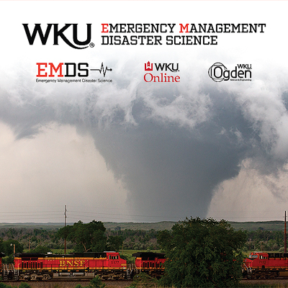
The Advantage of Having a Co-Credential

Slide 9
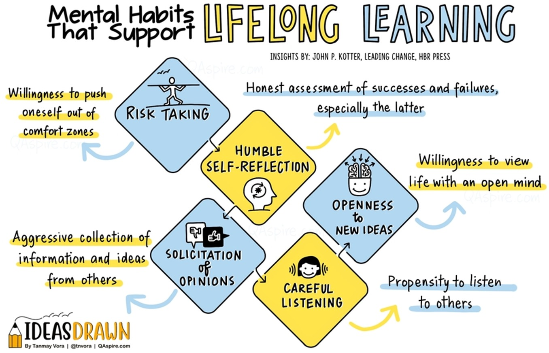
Embrace Life-Long Learning for Yourself and Your Team
The Pace of Change in Technology and Regulations is Accelerating
Regulatory Climate is a Politically Driven Rollercoaster
Need for Continued Learning is Essential
Adapt Training to Fit within your Operational Realities
Develop a Plan to Assure Training is a Priority
Make Professional Development a Budgetary Priority
Breakdown Complex Topics into Small Lots
Take Time to Develop Critical Task Procedures

Slide 10
Be Malleable in Method but Steadfast in Principles
Embrace the Following Realities:
You are in a Regulatory Driven Profession
You are Dealing with Customers whose Core Business is Not Safety and Who are Equally or More Passionate about their World View
They are not Always Wrong nor the Natural Enemy of Safety Professionals
There is usually more than One Route to a Compliant Solution
Establish Your Personal “Line in the Sand”:
You cannot Compromise Your Professional Ethics and Maintain Credibility
Being a Safety Professional Requires Continuous Research and Engagement
Be willing to Admit You're Wrong and Pivot if Warranted
Remember that Everyone Works for Someone, Sometimes you will get Overruled
Keep Your Resume Fresh, Have an Exit Strategy if You find Yourself in an Untenable Situation

Slide 11
Actively Drive Networking Beyond Electronic Media
Safety is a Field that Requires Personal Interaction
Use Email and Text as Tools but Not Your Only Tools
Develop an Advanced Interpersonal Skillset
Make Face-to-Face Interactions a Priority
Become a Catalyst for Conflict Resolution
Build Strong Professional Relationships – Peers/Mentors

Slide 12
Establish Your Personal Priorities Wisely
Plan for Life Balance
Work Hard and Have a Plan for Cross Training Key Functions
Take Your Vacation
Be Loyal to Your Employer but always Prioritize Your Family

Slide 13
Questions
?

Slide 14
Contact Information
Dr. David E. Oliver Ed.D., CSP, CEM
(270) 745-4181
David.Oliver@wku.edu

