Slide 1
OSHA Briefing
Carmen M. Martinez
Assistant Area Director
1/9/2026

Slide 2
OSHA Briefing
National Office OSHA Leadership
Oklahoma Area Office
OSHA’s Current Top 10 Most Cited (October 1, 2024, through September 30, 2025)
Enforcement
NEP/REP/LEP
OSHA Penalties
Cooperative Programs
FY 2025 to Present Oklahoma Fatal Event Cases

Slide 3
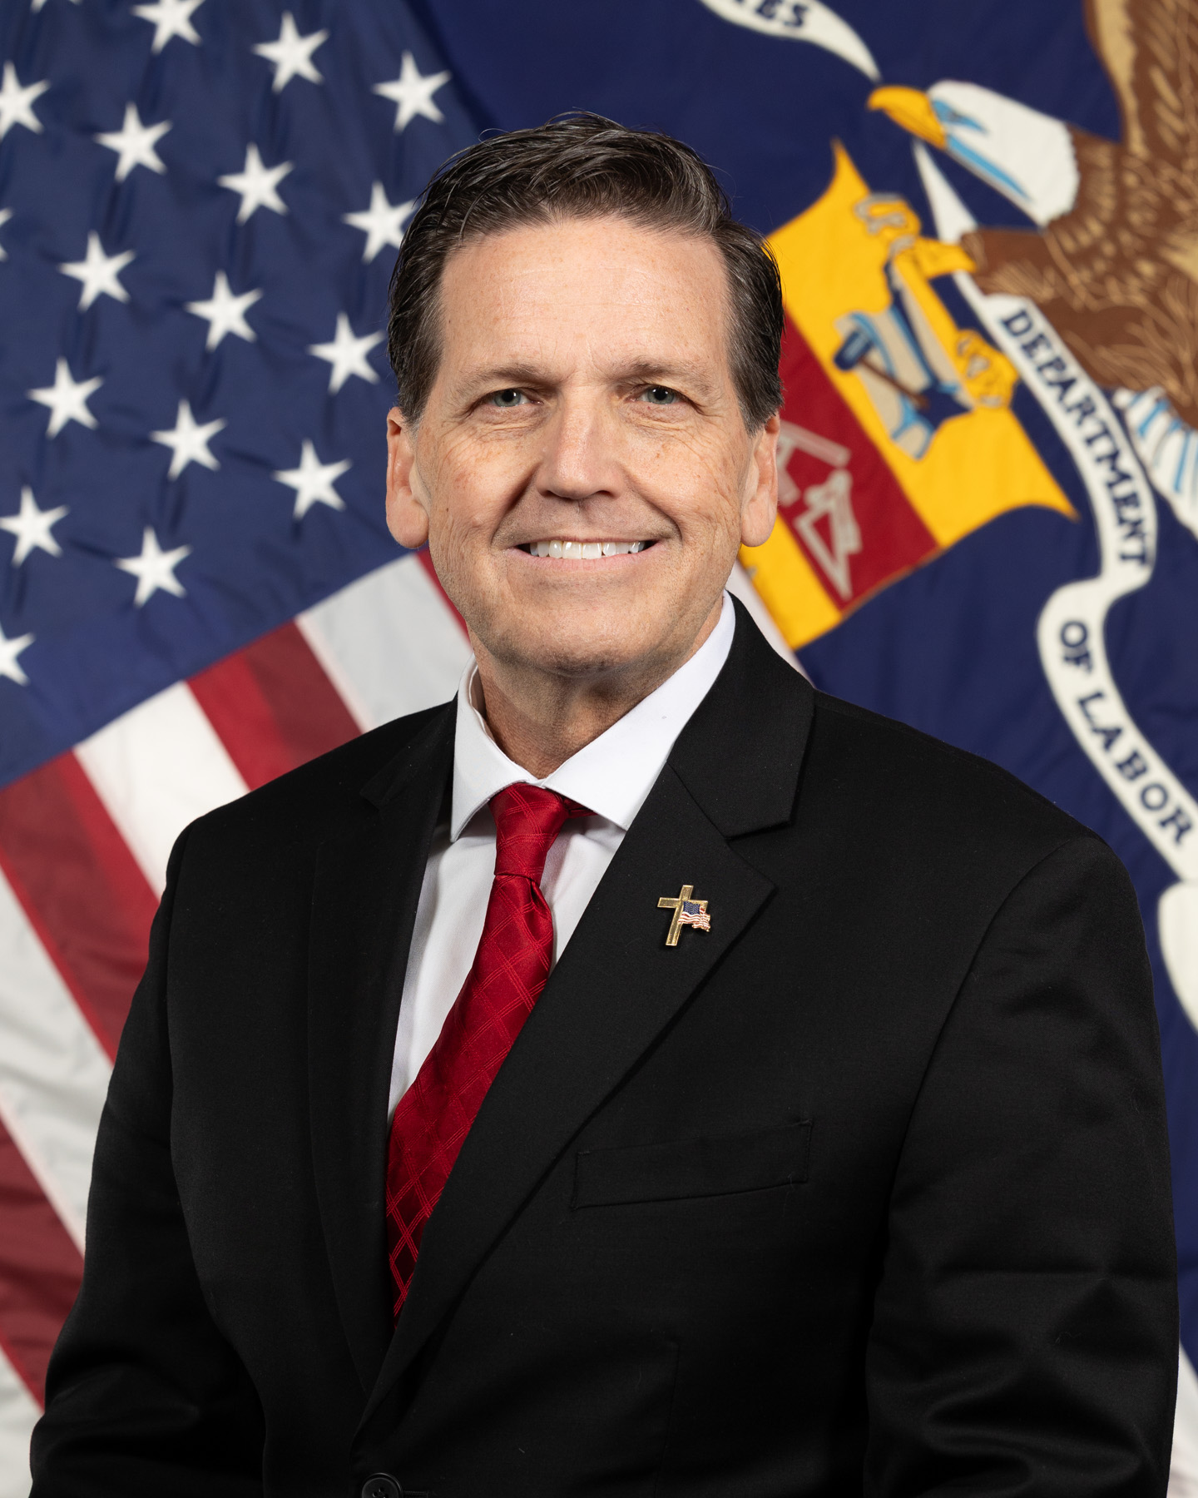
OSHA LEADERSHIP
David Keeling is confirmed OSHA Assistant Secretary on Oct. 2, 2025.
Previously served as VP, global health and safety at UPS, and director, global transportation safety at Amazon.

Slide 4
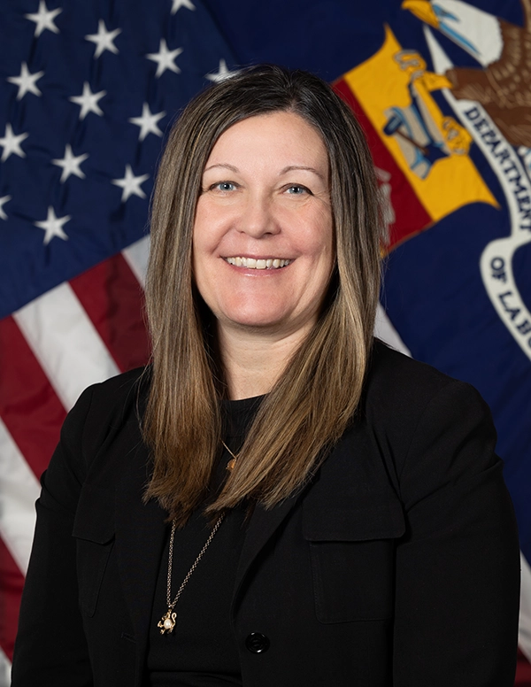
OSHA LEADERSHIP (continued)
Amanda Wood Laihow is the Deputy Assistant Secretary.
Previously served as commissioner on OSHRC, and served in the Senate Homeland Security and Governmental Affairs Committee and General Services Administration.

Slide 5
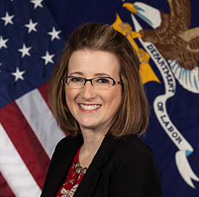
NATIONAL FAMILY LIAISON
Tonya Ford, OSHA's National Family Liaison, supports and assists families who lost a loved-one in a workplace incident.
Can be reached at a time convenient to families via email (ford.tonya.e@dol.gov) or phone at (531)893-3409.
Workers Memorial Tribute Wall.
  Family members can share their loved one’s photograph/written testimony at remembrance@dol.gov
Workers Memorial Day (April 28), events to honor and recognize fallen workers, and offer support to their families.

Slide 6
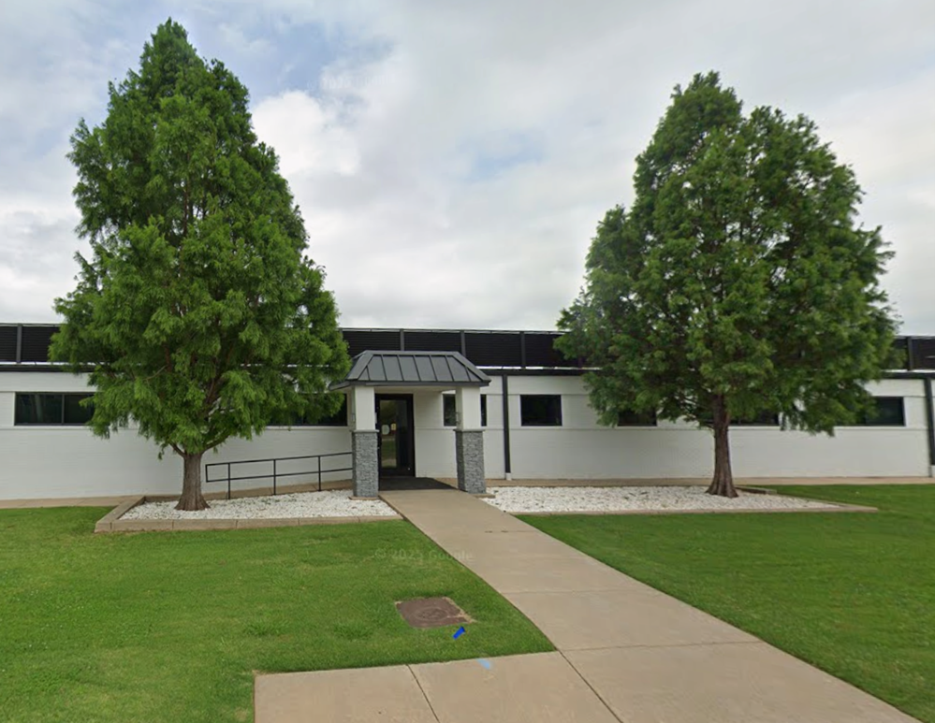
OSHA OKLAHOMA CITY AREA OFFICE
5104 N. Francis Ave, Suite 200
Oklahoma City, OK 73118
(405) 608-4160
www.osha.gov
1-800-321-OSHA

Slide 7
OSHA OKLAHOMA CITY AREA OFFICE
OKCAO Staff
Currently no Area Director
Carmen M. Martinez, Assistant Area Director
Currently no Compliance Assistance Specialist or VPP Coordinator
12 Compliance Officers
Regional Staff (in OKCAO)
Meghan Christie, Assistant Regional Administrator for Cooperative Programs
Renato Uribe, Whistleblower Supervisor

Slide 8
OSHA’s Top 10 Most Cited Standards - List
Oct. 1, 2024, through Sept. 30, 2025

Slide 9

OSHA’s Top 10 Most Cited Standards, #10
10
Machine Guarding
Standard 1910.212
Total Violations: 1,507

Slide 10

OSHA’s Top 10 Most Cited Standards, #9
9
        Personal Protective and Lifesaving Equipment – Eye and Face Protection
  Standard: 1926.102
  Total Violations: 1,968

Slide 11

OSHA’s Top 10 Most Cited Standards, #8
8
Powered
Industrial Trucks
Standard 1910.178
Total Violations: 2,167

Slide 12

OSHA’s Top 10 Most Cited Standards, #7
7
Fall Protection – Training Requirements
Standard 1926.503
Total Violations: 2,214

Slide 13

OSHA’s Top 10 Most Cited Standards, #6
6
Scaffolding
Standard 1926.451
Total Violations: 2,307

Slide 14

OSHA’s Top 10 Most Cited Standards, #5
5
        Respiratory Protection
    Standard 1910.134
    Total Violations: 2,327

Slide 15

OSHA’s Top 10 Most Cited Standards, #4
4
      Control of Hazardous Energy (Lockout/Tagout)
    Standard 1910.147
    Total Violations: 2,592

Slide 16

OSHA’s Top 10 Most Cited Standards, #3
3
Ladders
Standard 1926.1053
Total violations: 2,861

Slide 17

OSHA’s Top 10 Most Cited Standards, #2
2
Hazard Communication
Standard 1910.1200
Total violations: 3,036

Slide 18

OSHA’s Top 10 Most Cited Standards, #1
1
        Fall Protection
      Standard 1926.501
      Total violations: 7,035

Slide 19
OSHA’s Top 10 Most Cited Standards - List
Oct. 1, 2024, through Sept. 30, 2025
Fall Protection – General Requirements
Hazard Communication
Ladders
Control of Hazardous Energy (Lockout/Tagout)
Respiratory Protection
Scaffolding
Fall Protection – Training Requirements
Powered Industrial Trucks
Personal Protective and Lifesaving Equipment – Eye and Face Protection
Machine Guarding

Slide 20
ENFORCEMENT
OSHA sets enforcement policy and targeted inspection programs.
Respond to fatalities, catastrophes and complaints.
Emphasis Programs at the national, regional and local levels.

Slide 21
ENFORCEMENT PROGRAMS
NATIONAL EMPHASIS PROGRAMS (NEP)
Combustible Dust
Fall Prevention/Protection
Hazardous Machinery/Amputations
Heat (Now National EP and replaces REP)
Hexavalent Chromium
Lead
Primary Metal Industries
Process Safety Management (PSM)
Shipbreaking
Silica, Crystalline
Trenching and Excavation
Warehousing and Distribution Center Operations
REGIONAL EMPHASIS PROGRAMS (REP)
Construction
Cranes in Construction
Falls Hazards in Non-Construction
Grain Handling Facilities
Health Hazards in the Healthcare Industry
High Noise in Manufacturing Industries
Poultry Processing Facilities
Safety & Health Hazards in Manufacture of Fabricated Metal Products (MetalFab)
Upstream Oil & Gas Industry
Transportation Tank Cleaning Operations

Slide 22
NEP - AMPUTATIONS IN MANUFACTURING
The updated program issued on June 26, 2025, will be in place for five years.
Significant changes in the updated emphasis program include:
  An updated list of North American Industry Code System (NAICS) establishment codes identified for inclusion in the program.
  Allows establishments that had an inspection under the NEP in the previous 24 months and did not report an amputation to be removed from the programmed inspection list.
  Establishments with10 or fewer employees and their primary NAICS code is on the “Low-Hazard Industry Table” of the Appropriations Act Directive will not be inspected under this NEP.

Slide 23
HEAT NEP
Heat NEP 4/8/2022 - effective for 3 years
    Conducted for Summers of 2022, 2023, & 2024
    State Plan adoption was encouraged
Heat NEP extended 1 more year through 4/8/2026 - OSHA Notice 1/16/2025
    FY25 YTD 898 federal heat inspections, under the NEP
Compliance Assistance on all inspections when Heat Index > 80ºF
Programmed inspections for extreme heat advisory or warning
NEP targets construction, general industry, maritime, agriculture
    Over 70 high risk industries, both indoor and outdoor work
State Plans- all heat-related inspections, FY25 YTD - 3,647
    A majority of these inspection (over 2,000) were performed in California.

Slide 24
HEAT
  Well-known hazard for indoor/outdoor workers that can cause to serious or fatal illness.
  Workers should have adequate water, rest breaks, and shaded areas.
  Train employees on heat illness prevention, signs of heat illness and how to respond to a coworker showing signs of heat-related illness.
  New/returning workers should acclimate to heat gradually.

Slide 25
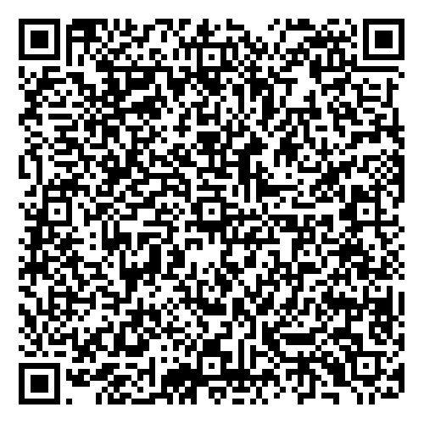
HEAT RULE/REGULATORY AGENDA
Public hearing began on June 16, 2025.
Archived recordings of the hearing on OSHA’s rulemaking page at https://www.osha.gov/heat-exposure/rulemaking.
To see OSHA’s full regulatory agenda visit the reginfo.gov or use this QR Code.

Slide 26
PENALTY UPDATES
Updated procedures focus on prevention and prompt hazard abatement.
Increased penalty reductions make it easier for small businesses to invest resources in compliance and hazard abatement.
Employers can benefit if they:
  Immediately address or correct hazard,
  Have never been inspected by federal/state OSHA,
  No history of serious, repeat or failure-to-abate violations, or
  Were inspected in previous five years but had no serious, willful or failure-to-abate violations.
Effective July 14, 2025.

Slide 27
PENALTIES
Type of Violation | Penalty Minimum | Penalty Maximum
Serious | $1,221** per violation | $16,550 per violation
Other-Than-Serious | $0 per violation | $16,550 per violation
Willful or Repeated | $11,823* per violation | $165,514 per violation
Posting Requirements | $0 per violation | $16,550 per violation
Failure to Abate | N/A | $16,550 per day unabated beyond the abatement date [generally limited to 30 days maximum]

Slide 28
CIVIL PENALTY ADJUSTMENTS
Reminder…
Federal Civil Penalties Inflation Adjustment Act Improvements Act (2015).
Annual adjustments for inflation no later than January 15.
2025 adjustments:
  Maximum penalties:
    For serious and other-than-serious violations from $16,550 per violation.
    For willful or repeated violations from $165,514 per violation.

Slide 29
FOM CHAPTER 6 PENALTY UPDATES
Allowable history percentage adjustment for a reduction/increase in penalty has been increased to 20% (Previously 10%).
  New eligibility criteria for employers never inspected by Federal OSHA nationwide or by any State Plan to receive a penalty reduction.
Expanded the size of small employers for penalty reductions:
  Serious and OTS: 70% reduction allowed for employers with 1-25 employees. Previously 1-10 employees.
  Willful-Serious: 80% reduction allowed for employers with 20 or fewer employees. Previously 10 or fewer.
New category of Quick-Fix added (Abatement within 5 days) to encourage prompt abatement of hazards

Slide 30




COOPERATIVE PROGRAMS and COMPLIANCE ASSISTANCE
Making real progress by working together.
Excellent ways to work with OSHA on meaningful safety and health initiatives.
Programs:
  On-Site Consultation Program
  Safety and Health Achievement Recognition Program (SHARP)
  Alliance Program
  Strategic Partnership Program
  Voluntary Protection Programs
  Safety Champions Program

Slide 31
Voluntary Protection Programs
OSHA’s new Pathway to Safety and Health Success:
Increase outreach to more employers, especially small businesses;
Reimagine OSHA Challenge into Safety Champions Program;
Expand use of Special Government Employees (SGE);
Incorporate leading indicators;
Create VPP Elite level of distinction for VPP sites → 15+ years of VPP status;
Create VPP Emeritus designation for VPP sites → 25+ years of VPP status;
Expand VPP SHMS from four to seven elements.

Slide 32
OSHA Safety Champions Program
A new program for employers to improve their safety and health programs.
Based on seven core elements of OSHA’s Recommended Practices for Safety and Health Programs.
Three steps: Introductory, Intermediate and Advanced.
SGEs given tools to work with participants as they progress through program.
Participants will receive recognition letter upon completion of each step.

Slide 33
ON-SITE CONSULTATION PROGRAM &
COMPLIANCE ASSISTANCE SPECIALISTS
Offers small businesses confidential occupational safety and health services.
    Separate from enforcement.
Onsite Consultants and OSHA Training Institute Education Centers work with employers to:
  find and fix workplace hazards,
  give advise for complying with OSHA standards,
  help establish and improve safety and health programs, and
  train employees.
Find a CAS near you; https://www.osha.gov/complianceassistance/cas.

Slide 34
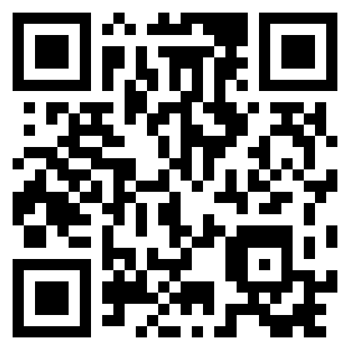
OSHA QUICKTAKES & MORE
QuickTakes: Stay up-to-date with OSHA news, initiatives and actions
Let us know if you have a safety story you would like to share for our upcoming newsletter at osha.quicktakes@dol.gov
Información Rápida: Spanish language version of the newsletter.
This Just In: breaking updates
DYK?: Short, informative spotlights on
topics and resources
Sign up today! osha.gov/QuickTakes

Slide 35
OKLAHOMA FATAL EVENTS – FY2025
Type of Event:
8 Struck by or Crushed by
3 Electrocution
3 Workplace Violence
5 Falls
1 Explosion
Industry Event Occurred:
12 General Industry
1 Agriculture
7 Construction

Slide 36
Fatalities FY 2025
October 18, Employee at a convince store was stabbed during a robbery
September 29, Reported October 21, Employee working at a horse boarding facility was thrown from a horse. Was determined to not be work related as was helping personal friend with a horse that was not part of the operation.

Slide 37
Fatalities FY 2025
October 24, Employee at a crane hardware and rigging manufacturer slipped and struck his head while working on a sheaving machine.
November 20, An employee trying to identify an underground line was electrocuted when the protective barrier was breached.

Slide 38
Fatalities FY 2025
December 6, two employees at a tank and steel coating facility were crushed by a steel sheet when it became unstable and fell.
January 7, one employee driving a side-by-side was fatally struck by the equipment when it turned over. The employee was not wearing a seatbelt or helmet.

Slide 39
Fatalities FY 2025
February 14, one employee was fatally struck by a coil of wire that feel from a turn table arm while trying to remove a stuck inner ring.
March 5, one employee was electrocuted when the concrete pumper arm contacted an overhead powerline.

Slide 40
Fatalities FY 2025
March 18, one employee conducting sanitation services at a meat processing plan fell into the auger as it was in motion.
March 28, one employee fell through the skylight of a commercial building roof.

Slide 41
Fatalities FY 2025
March 31, one employee fell from a scaffold ladder while carrying construction equipment.
May 13, one employee was fatally shot while performing security work at an abandoned apartment complex.

Slide 42
Fatalities FY 2025
June 18, PIT operator left the cab of the forklift with the wheels unblocked and the forks loaded and in the elevated position. The forklift rolled and pinned the PIT operator into the concrete wall.
June 21, a crane technician was in use of a personal fall protection system while replacing the wire rope on the hoist of an industrial overhead crane. The employee's lanyard was caught in the rotating drum and pulled the employee under the drum. The employee was crushed by the harness.

Slide 43
Fatalities FY 2025
Jul 2, six employees transported, unloaded, set up, and were installing the match fuses to commercial grade fireworks/explosives. Five of the employees were young summer farm hands with no training or experience in pyrotechnics. An explosion occurred injuring all the employees including burning three employees with 2nd and 3rd degree burns over 80% of their bodies and one employee succumbed to his injury's days later.
Jul 21, an employee was electrocuted while installing temporary wiring due to a faulty main line transformer.
Aug 12, an employee was placing plaster while working in the man basket attached to a rough terrain forklift. The man basket was not properly installed and secured causing the basket to fall off the forks of the forklift. The basket struck the employee and fell onto the employee fatally wounding the employee.

Slide 44
Fatalities FY 2025
Aug 18, an employee was fatally shot when responding to an active shooter event.
Aug 19, an employee was assisting with the installation of a wind tower when the employee fell from the ladder more than 80 feet.
Sep 25, an employee was securing large tree trunks onto a trailer when one of the tree trunks rolled off crushing the employee.

Slide 45
OKLAHOMA FATAL EVENTS – FY2026
7 Fatalities in FY 2026
Type of Event:
1 Explosion
5 Struck by or Crushed by
1 Falls
Industry Event Occurred:
3 General Industry
1 Agriculture
3 Construction

Slide 46
Fatalities FY 2026
Oct 4, an employee began welding on a metal pipe that had previously contained ammonia nitrate, igniting the contents of the pipe causing the metal pipe to rupture.
Nov 4, an employee was found under the riding lawn mower he was operating. The employee was operating the riding lawn mower on a slope.
Nov 7, an employee was removing the pin of the trailer he was hauling and the soil farming truck started rolling and fatally pinned the employee between the truck and neck of the trailer.

Slide 47
Fatalities FY 2026
Nov 25, an employee (truck driver) was walking in the shipping and receiving yard when fatally struck by another semi truck.
Dec 5, an employee was operating an excavator that had a broken cab window. The employee stuck his head out the window to talk with the owner/supervisor and the hydraulics of the excavator arm failed striking/pinning the employees head between the excavator arm and the cab.
Dec 18, an employee standing next to his work truck was struck by a skid steer that did not have an operational back up alarm.
Dec 19, an employee was working from a height at a construction site when he fell from an unknown height. (investigation recently opened)

Slide 48


OSHA Contact Information
OSHA CARES
We want every worker to go home safe
osha.gov
800-321-OSHA (6742)
Thank you

Slide 49
Questions

