Slide 1
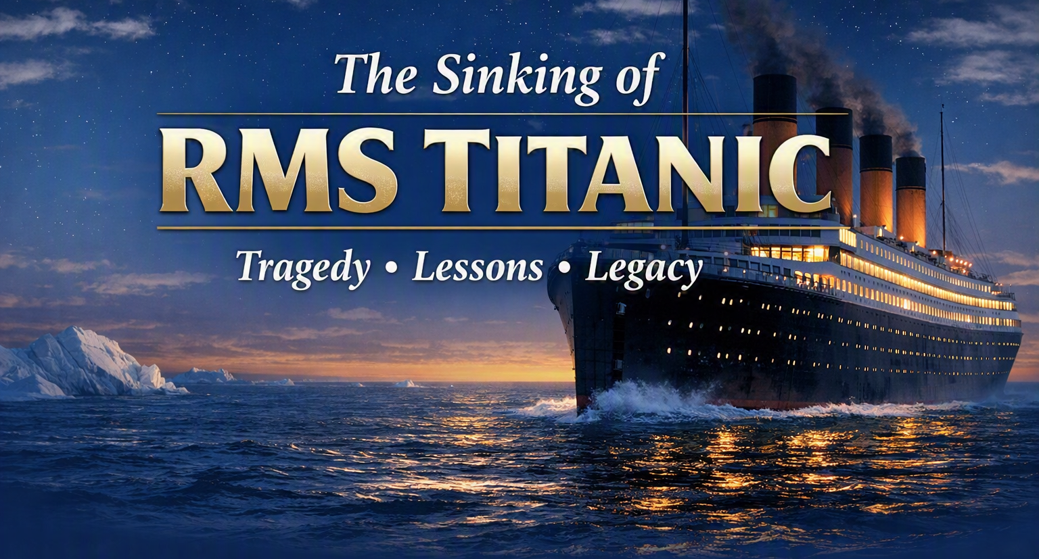


Anatomy of a Disaster — Design, Technology and the Night That Changed Maritime History

Slide 2
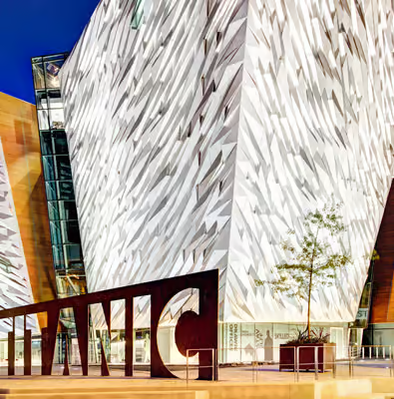

Slide 3
WHITE STAR LINE
Triva
What does RMS in the name RMS Titanic mean?
RMS = Royal Mail Ship
Ships with the prefix carried mail/post under contract for the British Royal Mail.
April 14–15, 1912
North Atlantic Ocean
41°43′N 49°57′W

Slide 4
Triva
WHITE STAR LINE
What is the origin of the Name, Titanic?
The RMS Titanic was named after the Titans of Greek mythology. They were powerful deities. They were trying to convey a sense of the ship’s immense size and strength with that name.
It was part of the White Star Line’s Olympic Class. Sister Ships were the Olympic and the HMHS Britannic.
April 14–15, 1912
North Atlantic Ocean
41°43′N 49°57′W

Slide 5
Objectives
WHITE STAR LINE
1. Identify the key contributing factors that led to the Titanic disaster.
2. Analyze how human factors and leadership decisions influenced the chain of events that resulted in the Titanic tragedy.
3. Apply the lessons learned from the Titanic to current workplace environments.
4. Develop a greater appreciation for the value of learning from historical disasters to prevent future incidents and strengthen organizational resilience.
April 14–15, 1912
North Atlantic Ocean
41°43′N 49°57′W

Slide 6
HARLAND & WOLFF, BELFAST · 1909–1912
Engineering at Scale — Design & Construction
882.5 ft
46,328
LENGTH OVERALL
GROSS REGISTER TONNAGE
269 metres · Largest moving object
Ever built at launch
GRT · Olympic-class flagship
·White Star Line
3,000+
£1.5M
WORKFORCE
CONSTRUCTION COST
Skilled workers at Harland & Wolff
· 3 million rivets placed
Approx. $200 million today · 26,000
tons of steel
Built at Harland & Wolff in Belfast between 1909 and 1912, Titanic was one of three Olympic-class liners for the White Star Line. At launch she was the largest moving object ever built, requiring 3 million rivets and 26,000 tons of steel. Her double-bottom hull and 16 watertight transverse bulkheads were considered state of the art.

Slide 7

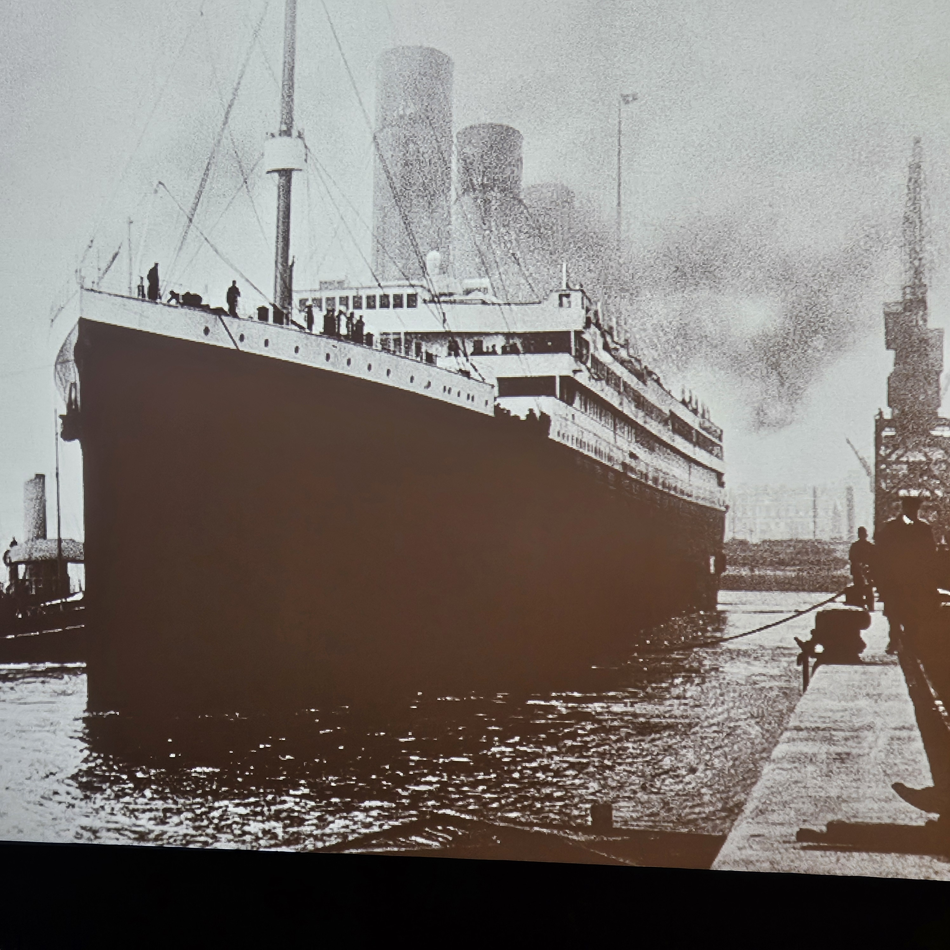
A Ship Ahead of Her Time — Technological Innovations
16 Watertight Bulkheads
Double-Bottom Hull
Marconi Wireless Telegraph
Electric Passenger Elevators
Triple-Screw Propulsion
Submarine Signaling

Slide 8
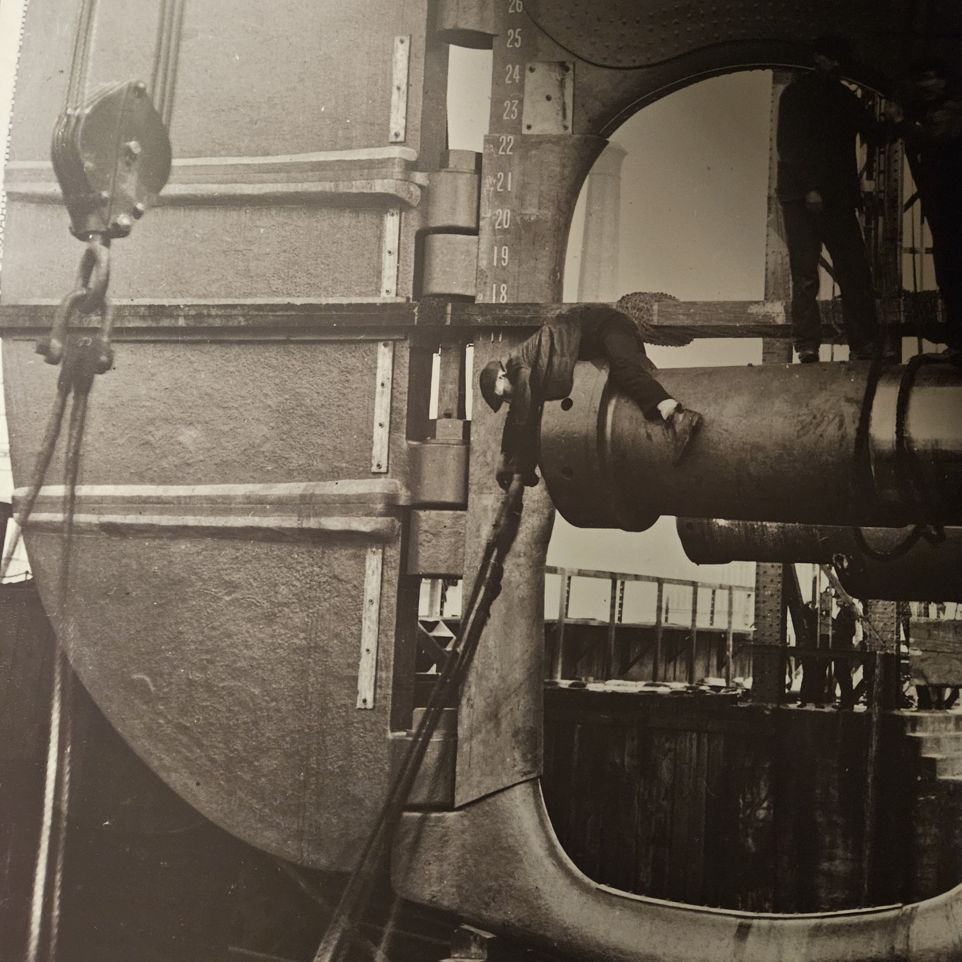
Before the Sinking of the Titanic
Eight people died during the ship's construction. According to National Geographic, eight men died during the construction of the ship, but only five of their names are known:
Samuel Scott,
John Kelly,
William Clarke,
James Dobbin, and
Robert Murphy.
There were 254 recorded “accidents”
During the construction of the Titanic

Slide 9
Impact – The Collison Sequence
11:39 PM Iceberg Spotted. Lookout rings the crow’s nest bell three times and phones the bridge. Officer Murdoch orders a hard-a-starboard and full astern on all engines
No time to react! Steam-powered tiller needed up to 30 seconds to answer. Reversing engines killed rudder authority – the worst possible combination
Glancing Blow. The bow swings to port but cannot clear. An underwater ice spur scrapes ~300 feet along the starboard hull
Six Compartments Breached. Compartments 1-6 buckle open ~12 sq ft total breach. Designed to survive 4 - 6 is fatal.
Flooding rate 400 ton per minute

Slide 10
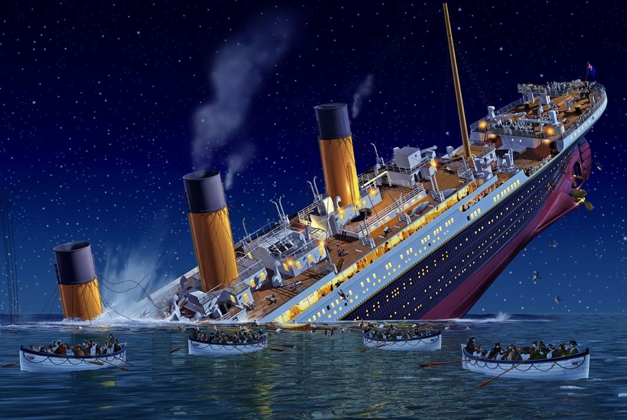
Fate Sealed
The Captain is told the ship has 1 to 1.5 hours. She fights for 2 hours and 40 minutes. Enough time to evacuate, but not enough lifeboats
The ocean water temperature at the surface during the sinking of the Titanic was approximately 28 degrees Fahrenheit.

Slide 11
Titanic Evacuation Timeline: From Collison to Final Plunge
11:40 PM Collision With Iceberg
12:05 AM Distress Calls Sent
12:25 AM Abandon Ship Order Given
12:45 AM First Lifeboat Launched
12:45 AM to 2:00 AM Lifeboats continue to be launched
2:05 AM All Lifeboats launched and away
2:17 to 2:20 AM The Titanic Sinks

Slide 12
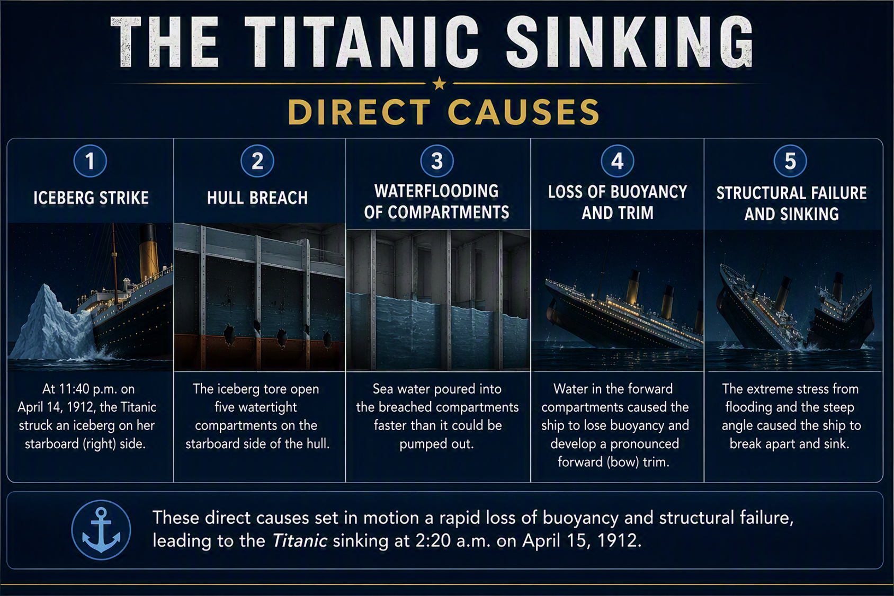

Slide 13
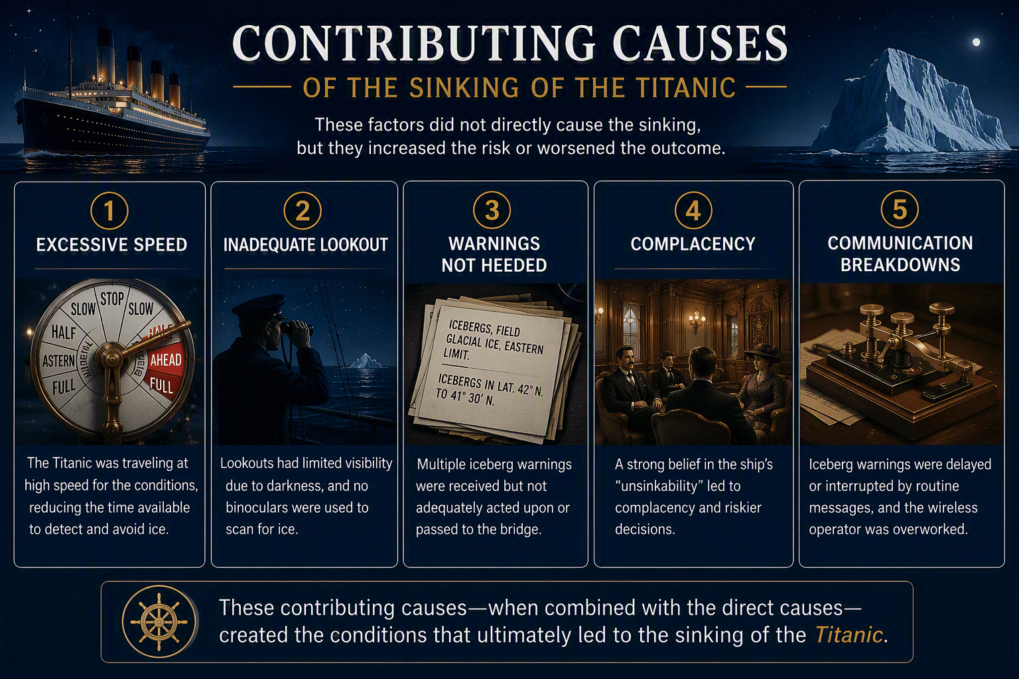

Slide 14
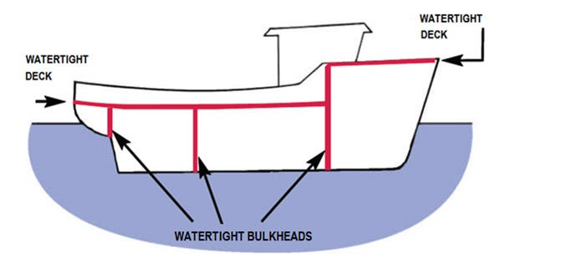
Why Bulkhead Design Contributed Directly to Sinking
The iceberg opened six compartments → more than the ship could survive.
The bow sank low enough that water spilled over bulkhead tops.
Flooding progressed aft in a domino effect, overwhelming each compartment
in turn.
Once progressive flooding began, no pumps or countermeasures could stop it.
Titanic’s subdivision provided delay,
not containment. The bulkheads slowed
the sinking but could not prevent it once
overtopping began..

Slide 15
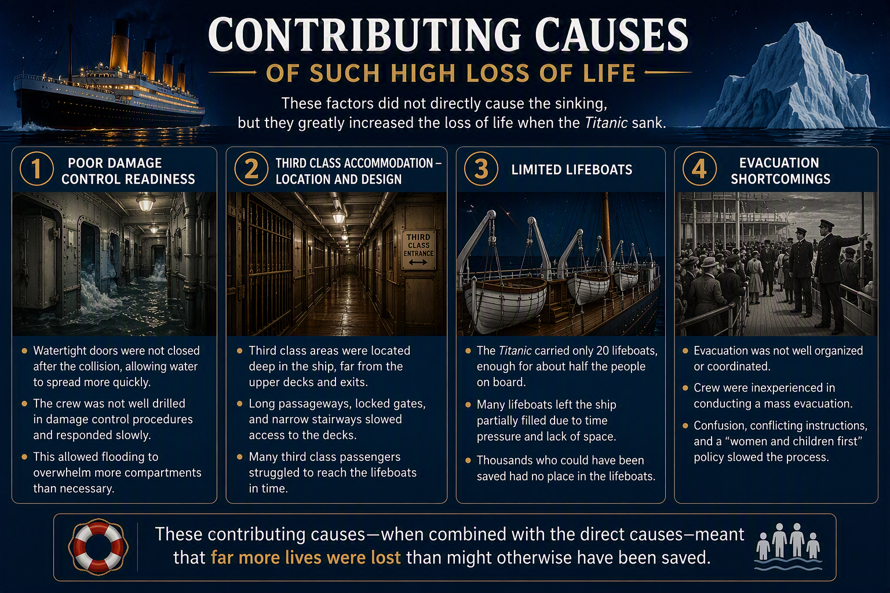

Slide 16
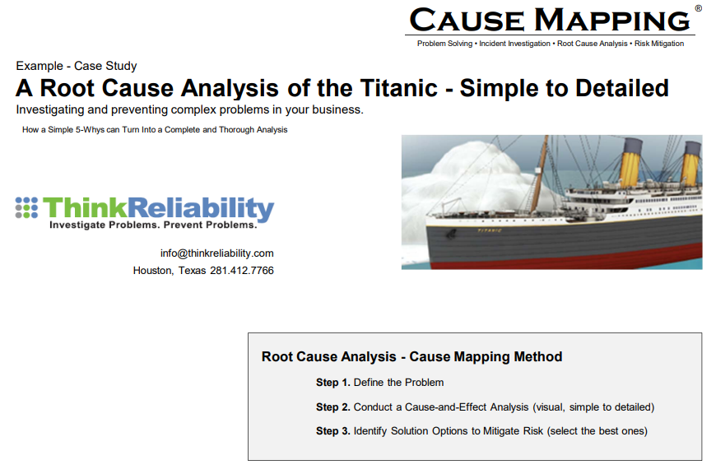
https://blog.thinkreliability.com/the-sinking-of-the-titanic-cause-map

Slide 17
Given the Number of Lifeboats, 53% Could Have Been Saved
472 Lifeboat Seats Were Unused
713 Saved
1512 Lost
Tragedy of The Response
75 % of Women Were Saved
51% of Children Under 15 Were Saved
20 % of Men Were Saved
2225 People On Board
32% Were Saved
20 Lifeboats On Board, 18 Launched
2 Collapsible Lifeboats Floated Off The Deck
12 Dogs On Board
3 Dogs Saved
Lifeboat No. 1 Had a Capacity of 65, But Launched With Only 12 People
The Better Your Class of Ticket, The Better Your Survival Rate

Slide 18
Hubris and Complacency Stifle Imagination
Hubris means excessive pride, extreme self-confidence, or arrogance that often leads to a person's downfall.
Complacency is a feeling of calm self-satisfaction with your current abilities or situation that blinds you to hidden risks.
Imagination is the human ability to form mental images, sensations, and concepts that are not physically present or have never been directly experienced.

Slide 19

Incident Imaging
Is the act of visualizing in one’s mind that combination of variable factors that could come together under the right circumstances to cause an incident.

Slide 20
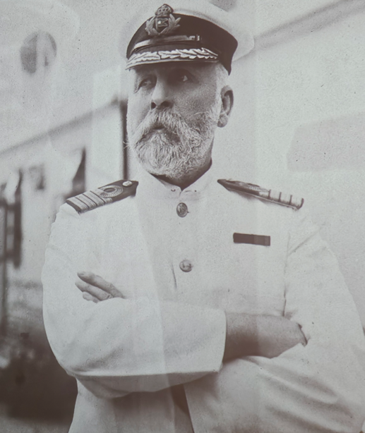
I CANNOT IMAGINE…
“When anyone asks me how I can best describe my experiences of nearly forty years at sea, I merely say uneventful. Of course, there have been winter gales and storms and fog and the like, but in all my experience I have never been in an accident of any sort worth speaking about. I have seen but one vessel in distress in all my years at sea, a brig, the crew of which was taken off in a small boat in charge of my third officer. I never saw a wreck and have never been wrecked, nor was I ever in any predicament that threatened to end in disaster of any sort.
I will say that I cannot imagine any condition which
could cause a ship to founder. I cannot conceive of any
vital disaster happening to this vessel. Modern shipbuilding
has gone beyond that.”
Captain of the Titanic: E.J. Smith

Slide 21
Learning From the Past

Slide 22
Learning From Incidents
Triangle Shirtwaist Factory Fire: https://www.britannica.com/event/Triangle-shirtwaist-factory-fire
Texas City Explosion: https://www.britannica.com/place/Texas-City
Piper Alpha Disaster: https://www.britannica.com/event/Piper-Alpha-disaster
Challenger Disaster: https://www.britannica.com/event/Challenger-disaster
Deepwater Horizon: https://www.britannica.com/event/Deepwater-Horizon-oil-spill

Slide 23
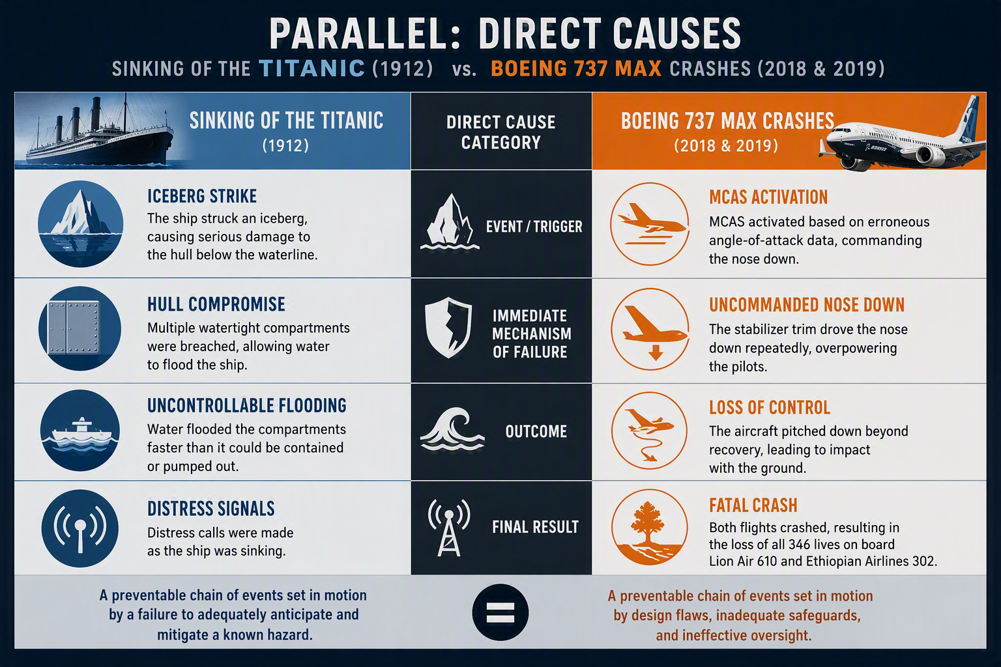

Slide 24
IN MEMORIAM
1,517 lives lost.
April 15, 1912
The wreck of RMS Titanic rests 12,500 feet beneath the North Atlantic. But her legacy endures in every lifeboat drill, every satellite distress signal, and every international maritime safety standard that has kept seafarers and passengers safe for over a century.
The names of all 1,517 victims are preserved at Encyclopedia Titanica (encyclopediatitanica.org)
Sources: US Senate Inquiry (1912) · British Wreck Commissioner's Inquiry (1912) · SOLAS Convention (1914/1974) · Encyclopedia Titanica · Lloyd's Register Foundation · NOAA · National Geographic

Slide 25

Thank you
W. C. Young
Safety Advisor, OESCO
wyoung@oesco.com

