Slide 1
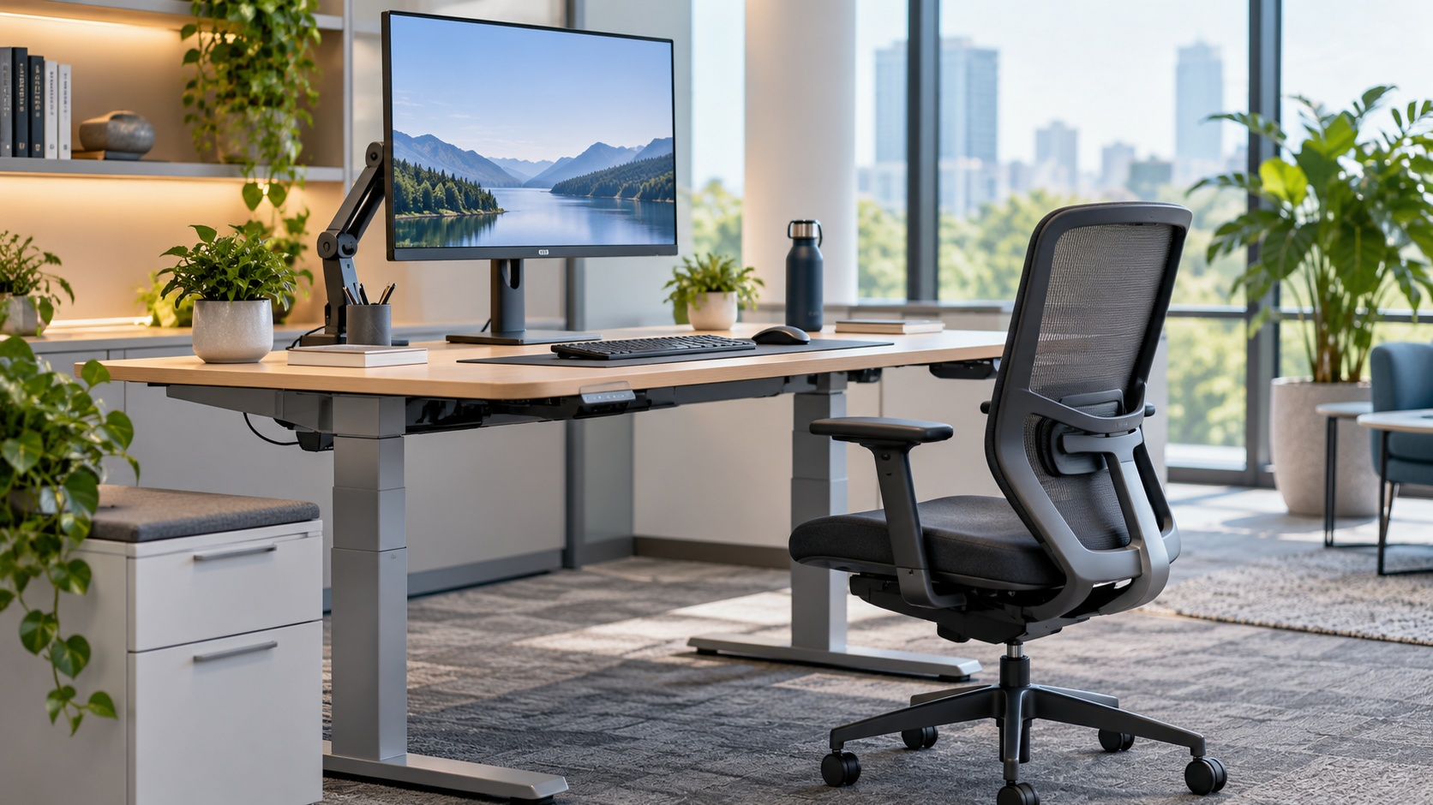
Neutral Postures, Better Work
Neutral posture for computer use
Jerrie Looney
OGE Sr Health & Safety Representative
ASSP OKC Chapter, 10.2.26
Neutral Posture, Better Work
Notes:
Open by framing the session as practical: this is not a deep technical course; it is a quick way for safety professionals to recognize computer-user ergonomic risk factors and make basic workstation adjustments. Mention the expected length and encourage questions as the group goes.

Slide 2
FRAMING THE PROBLEM
Office ergonomics is still safety work
Safety teams often recognize industrial hazards — but computer users can become the silent worker group.
1
Industrial ergonomic risk factors - more obvious
Reaching, bending, exertion, lifting – resulting in job rotation or engineering changes are familiar safety territory.
2
Computer based risk factors - subtle
Neck, shoulder, wrist, and hand discomfort may accumulate before anyone notices a safety concern.
3
Know what to look for
Identify risk factors quickly and adjust the workstation to the worker.
Key idea
Computer work may look low-risk, but sustained awkward posture + frequency can create unrecognized risk factors.
Neutral Posture, Better Work
02
Notes:
Use your industrial ergonomics background to build credibility: insertion forces, engine component location, reaching, bending, foam ramps, elevated bins, engineering spec changes, job rotations, and job enlargements. Then pivot: computer users are easy to walk past because the hazard is not dramatic.

Slide 3
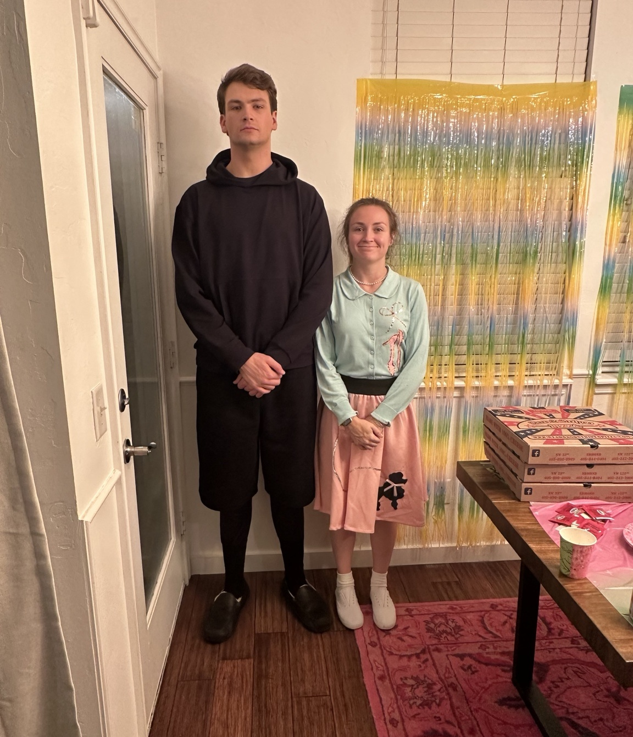
OLDER FIXED EQUIPMENT
The fixed workstation problem
Fixed-height desks/tables are typically a standard
29" height.
This requires several workarounds to fit different sized workers.
1
Taller worker
Raise the fixed desk and provide a tall chair.
2
Shorter worker
Add a keyboard tray, tall chair, and footrest.
The Catch: The setup must be reconfigured with each worker turnover
The workforce spans a wide range of body sizes.
Neutral Posture, Better Work
03
Notes:
Explain the 29-inch standard desk example. The point is not that 29 inches is always wrong; it is that a fixed surface creates awkward compromises. In the old approach, taller users needed raised desks and tall chairs; shorter users often needed keyboard trays, tall chairs, and footrests. Those fixes were tedious and tied to one worker.

Slide 4
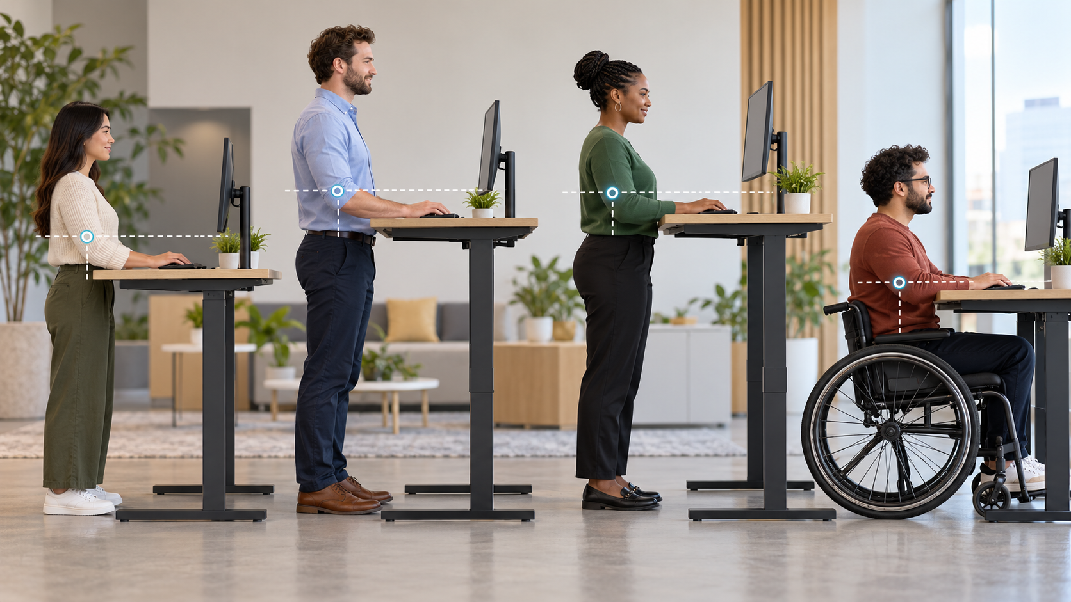
HATS: THE GAME CHANGER
Height adjustable tables changed the conversation
1
Fit changes with the worker
2
Comfort improves quickly
A height-adjustable table allows a custom height for every worker
Re-adjust when people move roles or share a workstation.
People notice when strain drops.
Neutral Posture, Better Work
04
Notes:
Use this slide to discuss how height adjustable tables reduced the fixed workstation problem. In the notes, this was described as a game changer for comfort and fitting the desk to the worker. Stress that the equipment only helps if the user knows how to adjust it.

Slide 5
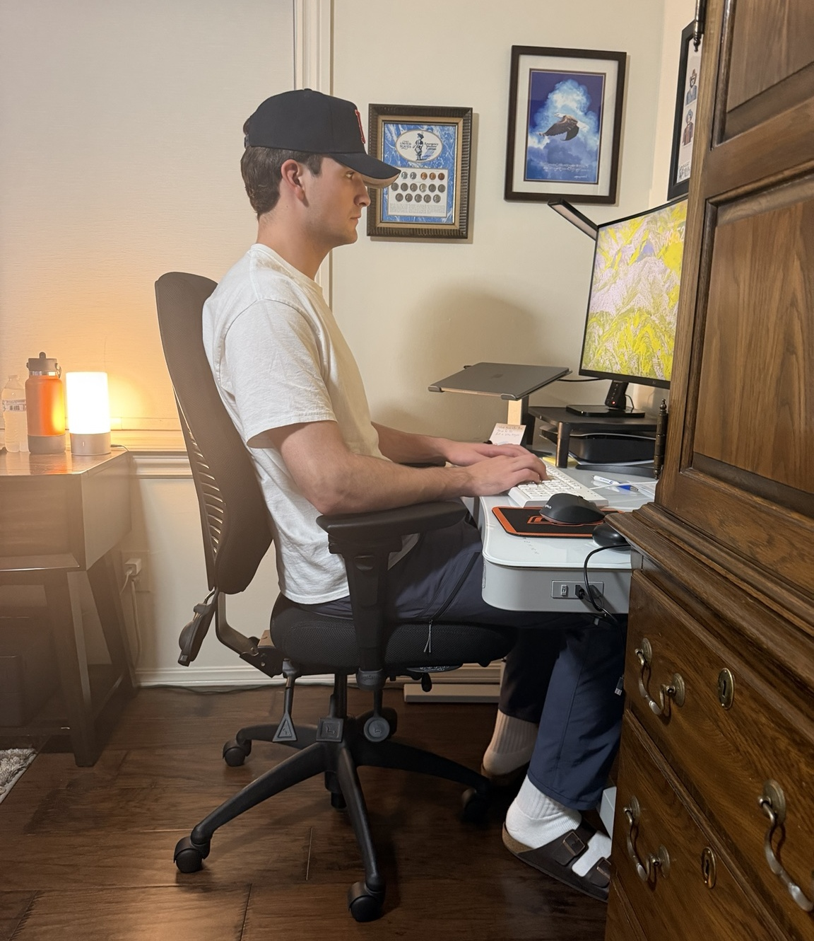
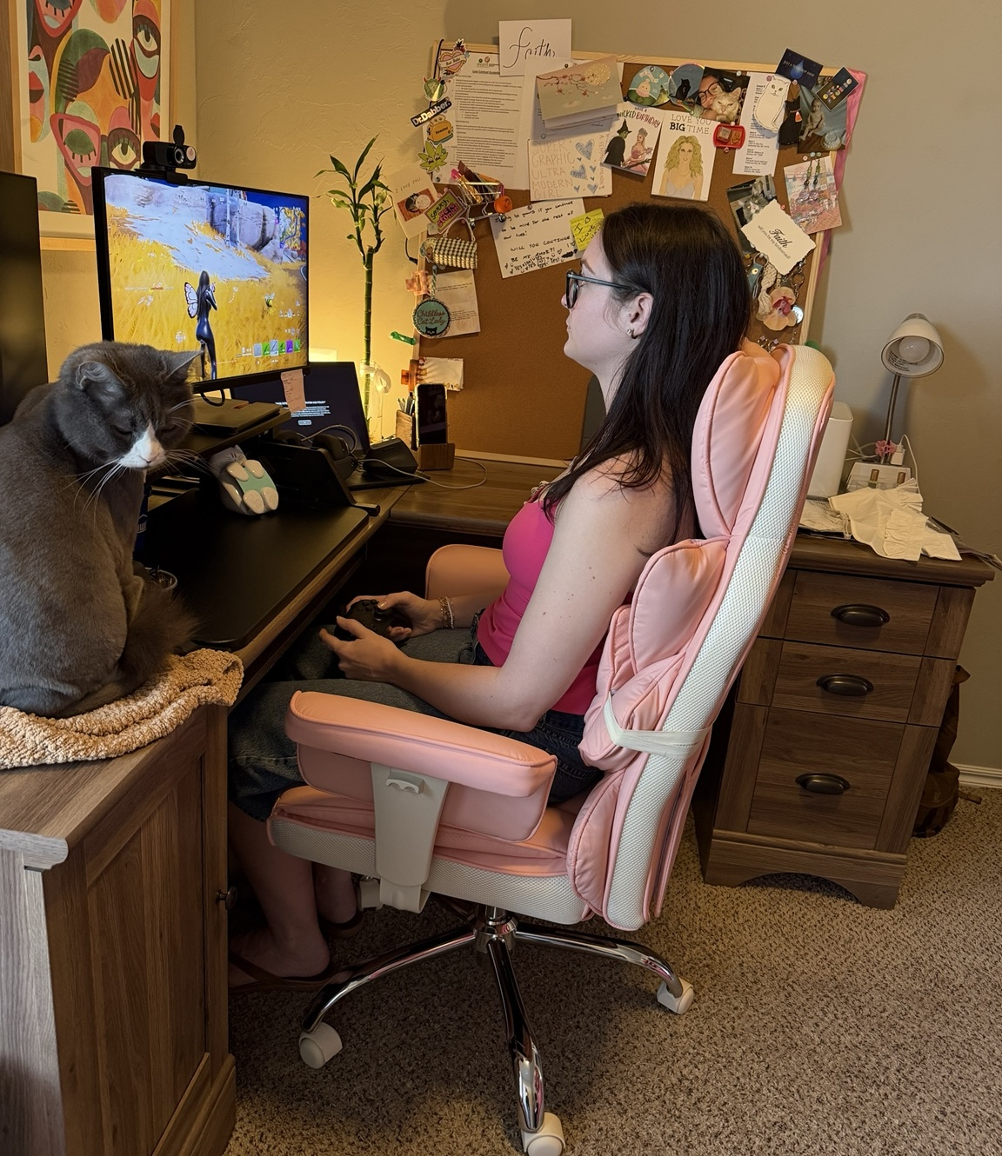
TRIGGER POINTS
Who should get an ergonomic assessment?
REAL-WORLD EXAMPLES
60%+
Gaming counts, too
of the workday on a computer = frequent user
1
Reports of discomfort
Neck, shoulder, wrist, hand, or low back discomfort
2
New hires
Ergonomic assessment is rarely included in onboarding — but it should be. Especially for the 5th & 95th percentile workers
Be proactive.
Don’t wait for pain to be the signal.
Same principles. Different bodies. Different setups.
Neutral Posture, Better Work
05
Notes:
Present ergonomic assessment as preventive, not only reactive. Complaints are a trigger, but so are new hires, workstation changes, and heavy computer use. Emphasize the note that most workers without ergonomic awareness tend to set the desk too high, which often contributes to neck and shoulder discomfort.

Slide 6
ASSESSMENT SEQUENCE
Start with the foundation: chair
Foundation first – chair; then set table height
Then fine-tune monitor placement, keyboard and mouse choices
A workstation can have top-tier accessories and still be wrong if the chair and desk height fight the worker.
1
2
3
4
5
6
Feet
Seat pan
Lumbar
Recline
Armrests
Desk height
Flat on floor
or footrest
Support thighs;
clear behind knees
Low back supported
Slight lean back
Support, not shrugging
Approximately
elbow height
Neutral Posture, Better Work
06
Notes:
Walk the audience through the assessment sequence. Do not jump straight to monitors or keyboard gadgets. Start with chair and desk: feet flat, seat pan depth, lumbar support, slight recline, appropriate armrests, and desk adjusted to elbow height.

Slide 7
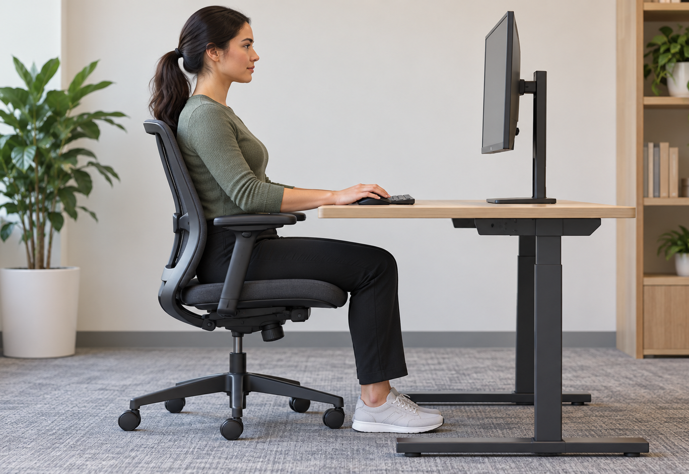
SIDE-VIEW CHECK
What neutral posture looks like
Head over shoulders
Neutral chin
Shoulders relaxed
Lumbar supported
Wrists straight
Feet flat
Hips slightly above knees
Mouse hand relaxed
Think “piano player”: relaxed shoulders, elbows close, wrists straight.
NOTE: armrest and desktop same height.
Neutral Posture, Better Work
07
Notes:
Use the side-view checklist. The image gives people something to look for: lumbar supported, feet flat, hips slightly above knees, seat pan not touching the back of the legs, head directly above shoulders, neutral chin, relaxed shoulders, straight wrists, and a relaxed mouse hand. Use the piano player analogy here.

Slide 8
MONITOR + KEYBOARD + MOUSE
Dial in the equipment after the foundation
Monitor
Keyboard
Mouse
Height + distance
Neutral wrists
Relaxed hand
Position the monitor so the head and chin stay neutral — not tilted up and not tilted down. Set the distance so the worker can view the screen without leaning forward.
Keep wrists straight and shoulders relaxed. Avoid tilting the keyboard.
Vertical and larger mice can help the hand rest instead of clutching a small travel-size device.
Look straight
Stay neutral
Rest, not clutch
Neutral Posture, Better Work
08
Notes:
After chair and desk height, move through monitor, keyboard, and mouse. Keep the explanation practical. Monitor height and distance should keep the head above the shoulders and chin neutral. Keyboard should allow neutral wrists. Mouse selection and placement should avoid clutching and over-reaching.

Slide 9
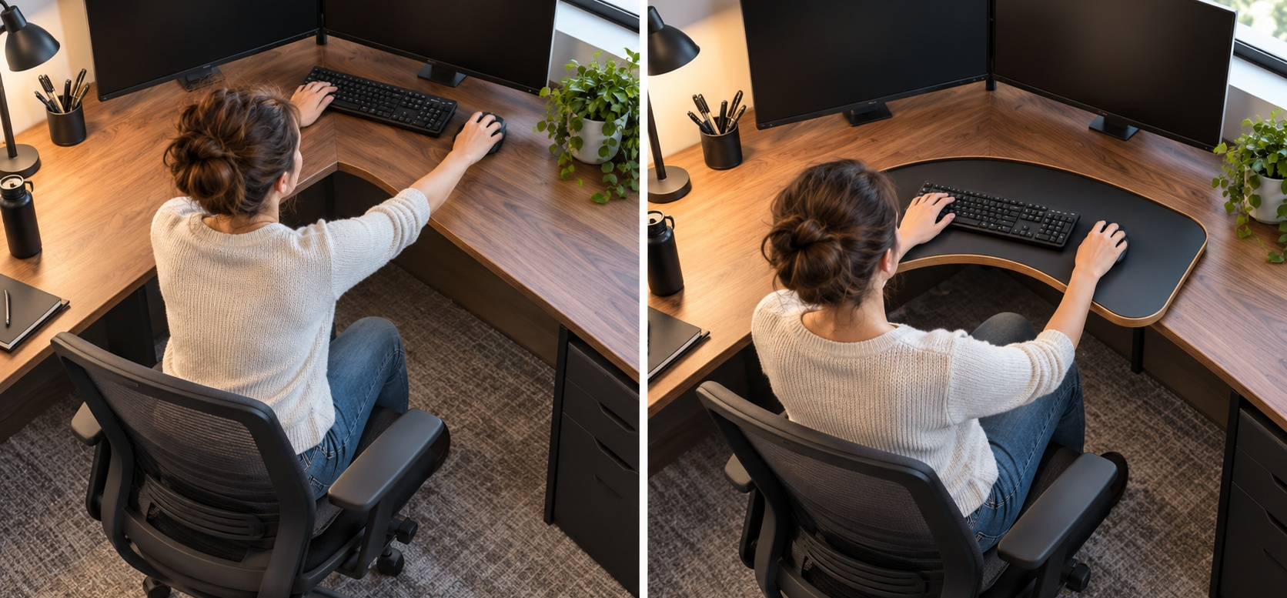
CORNER DESKS
On L-shaped desks, watch the reach
AVOID: keyboard deep in the corner
BETTER: bring inputs within easy reach
Inside corners can quietly turn into reach problems. The goal is simple: elbows close, shoulders relaxed, wrists neutral.
NOTE: Amazon has a simple clamp on corner adapter, $30
Neutral Posture, Better Work
09
Notes:
This slide is for a common workstation miss: reach. Mention the notes about being wary of corners and the desk corner adapter. If the worker is extending the arm, elevating the shoulder, or bending the wrist to reach the mouse, the setup is still creating exposure.

Slide 10
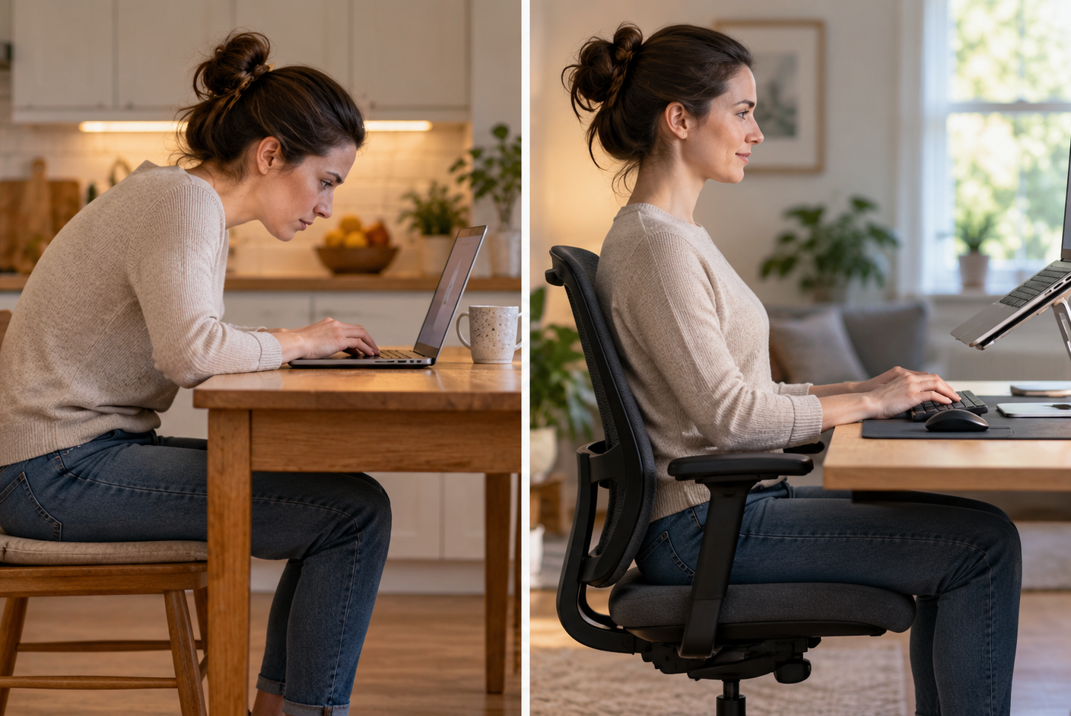
WFH
Work-from-home setups need the same principles
Simple WFH kit
1
Laptop stand
Raise the viewing angle.
2
External keyboard
Keep wrists neutral.
3
External mouse
Let the hand relax.
A laptop alone usually forces a choice: screen too low or keyboard too high.
Neutral Posture, Better Work
10
Notes:
The WFH message is simple: use a laptop stand and an external keyboard. The point is not to shame improvised home setups; it is to show that the same neutral posture principles apply outside the office.

Slide 11
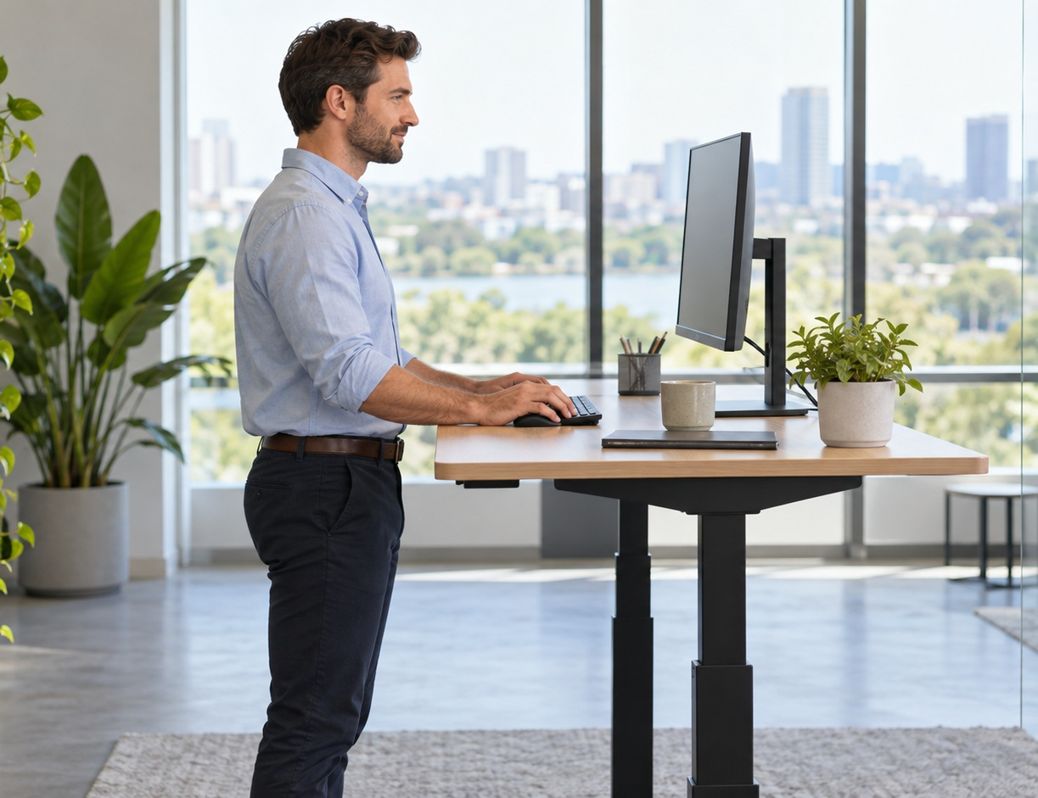
SIT / STAND BALANCE
Standing is movement — not a magic posture
1
Same setup rules
Desk at elbow height, relaxed shoulders, neutral wrists.
2
Raise the monitor
Standing setups often need extra monitor height.
3
Change positions
The best posture is often the next posture — build in movement.
4
Avoid all-day extremes
Neither sitting rigidly all day nor standing rigidly all day is the goal.
15 min / hour
A practical target for circulation benefits — breaks, walking, and restroom trips count too.
Neutral Posture, Better Work
11
Notes:
Use this slide carefully. Standing is useful, but the goal is not to stand all day. The notes say 15 minutes per hour is ideal for circulation, and that similar benefits can come from getting up and taking breaks. Explain that the same workstation principles apply at a standing desk, with monitor height often needing to rise.

Slide 12
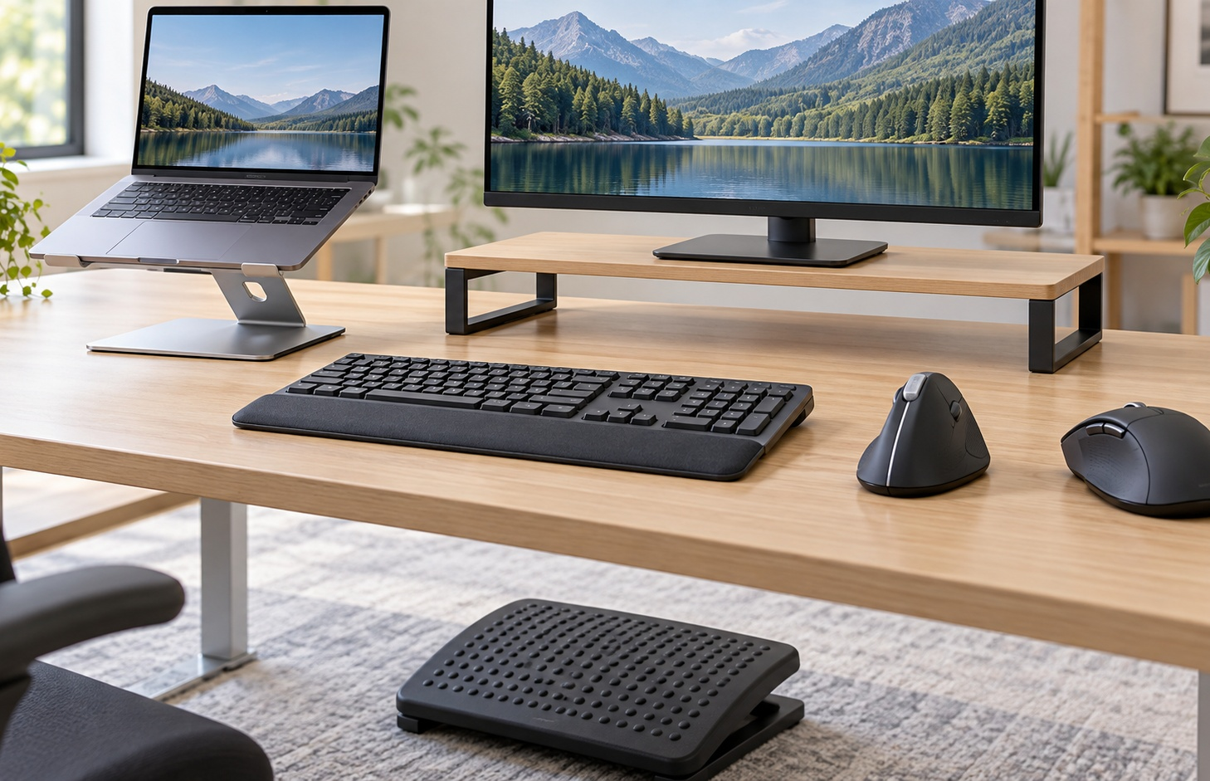
ACCESSORIES
Keyboards and mice: small choices, big payoff
The “ergonomic” choice is the one that lets the worker stay relaxed and neutral.
Fit still matters
1
Ergonomic keyboards
Often especially helpful for larger-shouldered users; expect a short adjustment period.
2
Vertical mice
Can place the wrist and hand in a more neutral position.
Workplace accessory examples
The best accessory is the one that helps the worker stay relaxed, keeps inputs within easy reach, and supports a neutral hand and wrist.
3
Larger mice
Allow the hand to rest rather than clutch a small travel mouse.
Neutral Posture, Better Work
12
Notes:
Explain that ergonomic keyboards are useful but may take a few days to adjust to finger placement. Vertical mice often support a more neutral wrist/hand position. Avoid small/travel-size mice for primary workstation use because they can encourage clutching rather than resting the hand.

Slide 13
Quick workstation check
Feet
flat / supported
Discussion / mini-demo
Hips
slightly above knees
Pick one workstation setup and ask:
Back
lumbar supported
1
What looks neutral?
Shoulders
relaxed
2
What looks strained?
Head
over shoulders
3
What would you adjust first?
Wrists
straight
Reach
close and easy
Takeaway: fit the workstation to the worker — not the worker to the workstation.
Neutral Posture, Better Work
13
Notes:
Close with the quick check: feet, hips, back, shoulders, head, wrists, and reach. For a 20-person ASSP chapter setting, invite a short discussion or mini-demo. Ask what looks neutral, what looks strained, and what should be adjusted first. End on the central takeaway: fit the workstation to the worker.

